Slide 1

Deep Learning Project
Text Generator Model

Slide 2
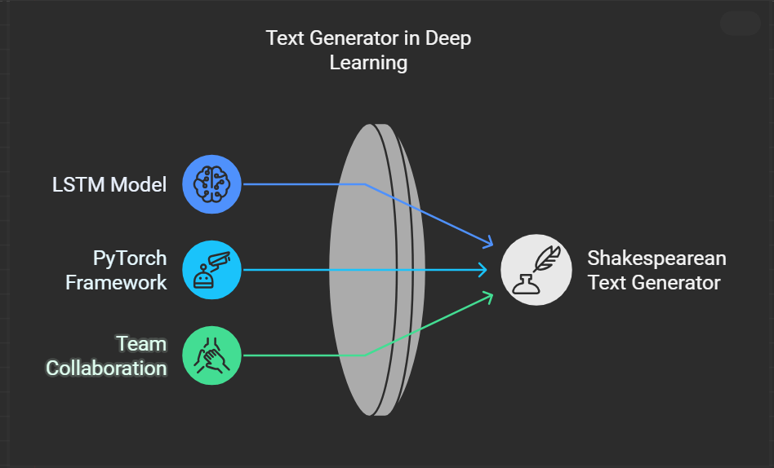
A Deep Learning Approach to Generating Shakespearean Text

Slide 3

Introduction
What is the Project?
A Python-based application that generates text resembling Shakespeare's works.
Combines a deep learning model (LSTM) with a graphical user interface (GUI).
Why is it Interesting?
Demonstrates the ability of LSTM to model sequential data like text.
Interactive GUI allows users to experiment with parameters like text length and creativity.

Slide 4
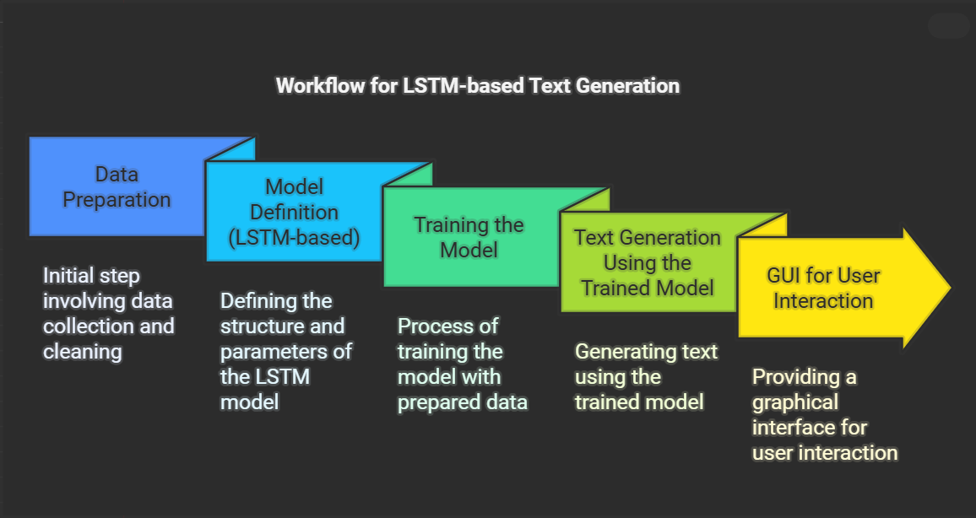

Slide 5
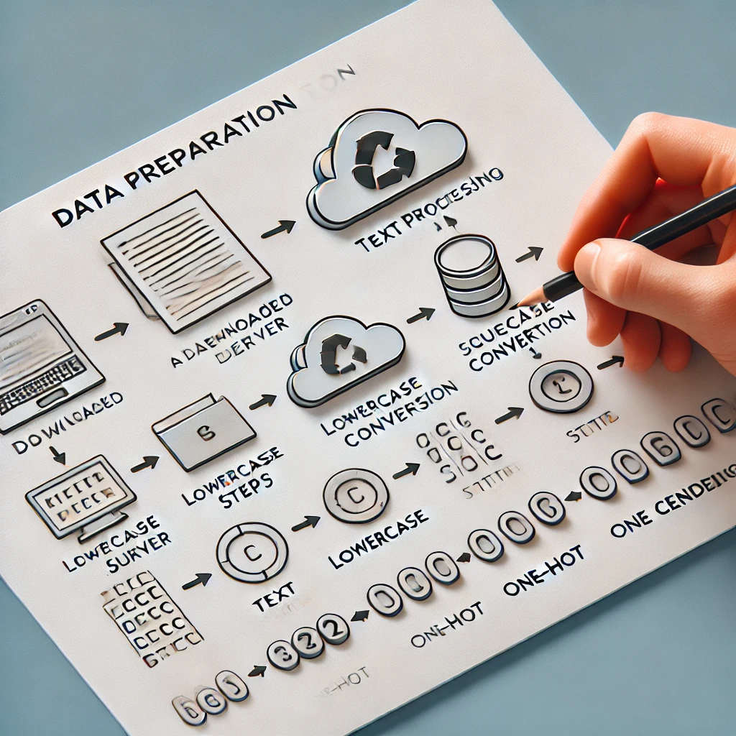
Data Preparation
1. Downloading and Reading Data
Shakespeare’s text is downloaded from a public URL.
The dataset is limited to a specific range of text for processing efficiency.
2. Preprocessing
Convert text to lowercase.
Create mappings for characters to indices and vice versa.
3. Feature and Target Creation
Divide text into sequences (inputs) and corresponding next characters (targets).
One-hot encode the inputs for compatibility with the model.

Slide 6
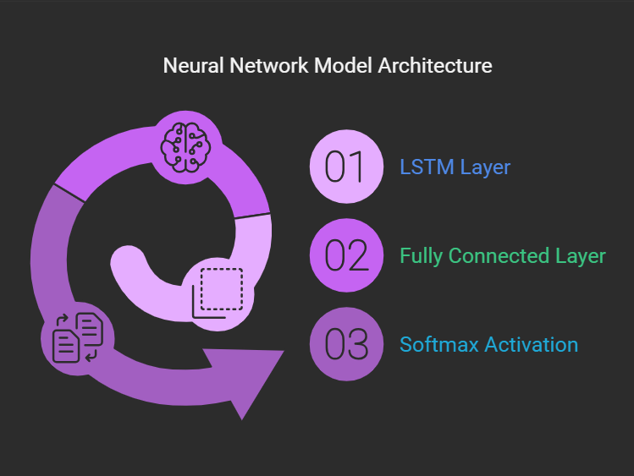
Model Definition
What is LSTM?
A type of Recurrent Neural Network (RNN) specialized in handling sequential data.
Capable of learning long-term dependencies.
Model Architecture:
LSTM Layer: Processes input sequences.
Fully Connected Layer: Predicts the next character.
Softmax Activation: Converts outputs to probabilities.

Slide 7
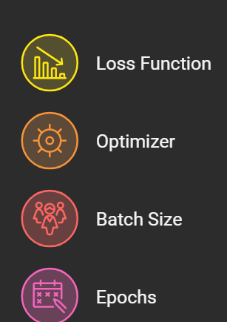
Training the Model
Training Details:
Loss Function: CrossEntropyLoss
Optimizer: RMSprop
Batch Size: 256
Epochs: 4
Training Process:
Feed input sequences into the model.
Compute predictions and compare with target characters.
Update weights to minimize loss.

Slide 8
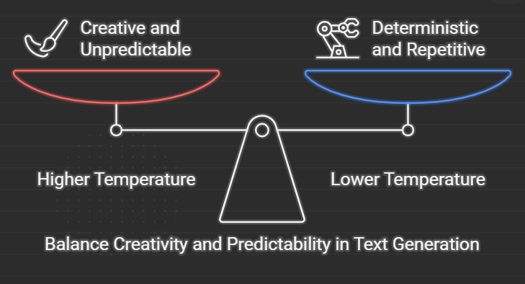
Text Generation
How It Works:
Provide a starting sequence from the dataset.
Predict the next character using the trained model.
Append the predicted character to the sequence and repeat.
Creativity Control:
Adjust "Temperature" to control randomness in predictions.
Higher values: More creative, less predictable text.
Lower values: More deterministic, repetitive text.

Slide 9
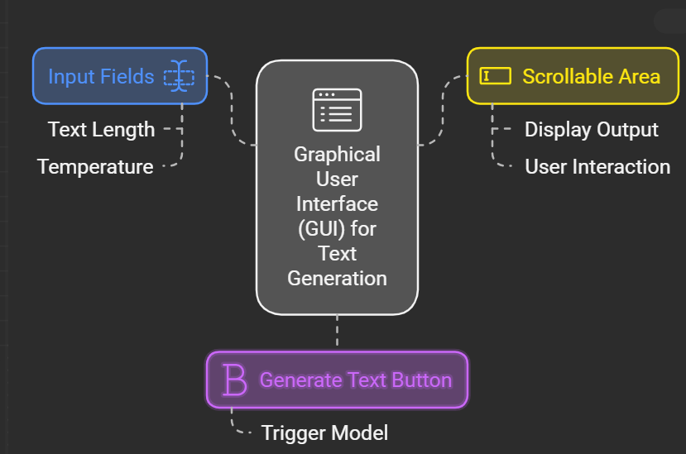
Graphical User Interface (GUI)
Built Using:
Tkinter (Python’s GUI library)
Features:
Input fields for text length and temperature.
"Generate Text" button to trigger the model.
Scrollable area to display generated text.

Slide 10
Team Members
Abdul-Rahman Hamdi Mokhtar (Leader)
Mahmoud Gamil El-Sayed Ahmed
Mostafa Mohamed Abo-Elyazeed
Abdul-Rahman Hussien
Youssef Sleem
Mohammed Adel
Mahmoud Wael Shabib

Slide 11
Under the supervision of
Eng.Omar El-Nahas

